Slide 1
The Basics
Types of cameras

Slide 2
Types of cameras
Film cameras
Digital cameras

Slide 3
Types of cameras
Film cameras
View camera
Viewfinder camera
Point and shoot or compact cameras
Single lens reflex camera (SLR)
Twin lens reflex camera (TLR)
Specialty cameras

Slide 4
Types of cameras
Digital cameras
Viewfinder camera
Point and shoot or compact cameras
Single lens reflex camera (SLR)
DSLR is the term for digital SLR cameras
Specialty cameras

Slide 5
View camera
Built like an accordion, with a lens in the front, a viewing screen in the back, and flexible bellows in between.

Slide 6
View camera
ADVANTAGES
Large film size (4x5, 5,7, 8x10)
Sharp detail
What you see in the viewfinder is exactly what you will get on the negative.
You can change the position of the film and lens relative to each other to correct distortion.
DISADVANTAGES
Bulky and heavy
Must use a tripod.
Image on the viewing screen is not bright so you have put a focusing cloth over your head and the back of the camera.
The image appears reversed and upside down on the viewing screen.
Rapid shooting is difficult.

Slide 7
View camera
Used for:
Commercial studio photography
Landscapes
Architectural photography

Slide 8
Viewfinder
A compact, lightweight, camera that allows you to view the scene through a small window.
Viewfinder cameras include inexpensive point-and-shoot cameras

Slide 9
Viewfinder
ADVANTAGES
Compact, lightweight, and fast handling.
Quieter than an SLR
Bright viewfinder image allows easy focusing.
DISADVANTAGES
Parallax error - Because the viewfinder is in a different position than the lens, you cannot see exactly what the lens sees. The closer the subject the more evident the parallax.

Slide 10
Single lens reflex
An SLR has a mirror and pentaprism that allow you to use the lens for viewing and focusing.
Most are 35mm, but some are medium format.

Slide 11
Single lens reflex
ADVANTAGES
Eliminates parallax - what you see is what you will get.
Easy to focus.
Usually has a built-in light meter.
DISADVANTAGES
Heavier and larger than a rangefinder.
Relatively complex with many parts that may need repair.
The mirror movement makes the camera loud and causes vibration.
Momentary black-out at the time of exposure.

Slide 12
Twin lens reflex
A TLR has a fixed mirror that reflects the scene upward onto a viewing screen.
There is one lens to expose the film and another to view the image.

Slide 13
Twin lens reflex
ADVANTAGES
Fixed mirror allows quiet operation.
Simple, rugged construction.
The viewing screen placement on top allows you to easily photograph from the ground or other awkward angles.
Medium-format film.
DISAVANTAGES
Parallax
It is difficult to follow moving objects because the image on the screen is reversed left to right.
It is a larger camera that can be somewhat cumbersome.
Difficult to use at eye level.

Slide 14
Specialty camera
Used for a specific purpose
Underwater cameras
Panoramic cameras
Polaroid Cameras

Slide 15
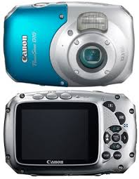
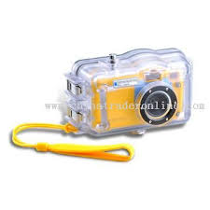
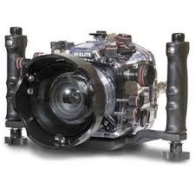
Specialty camera
Used for a specific purpose
Underwater cameras

Slide 16
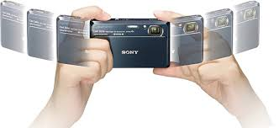
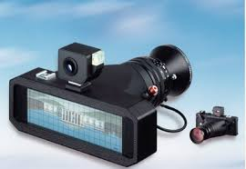
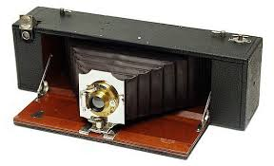
Specialty camera
Used for a specific purpose
Panoramic cameras

Slide 17
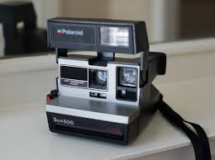
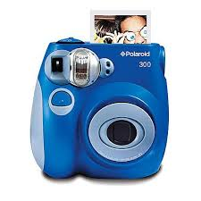
Specialty camera
Used for a specific purpose
Polaroid Cameras

Slide 18
Summary
You should be able to name the four types of cameras.
Can you name some examples of specialty cameras and their uses?

Slide 19
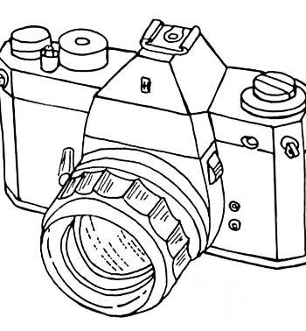
Types of cameras

Slide 20
Types of cameras

Slide 21
Types of cameras

Slide 22
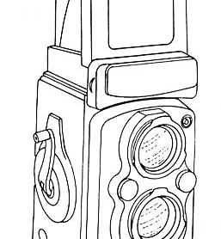
Types of cameras

Slide 23
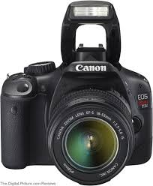
Types of cameras

Slide 24
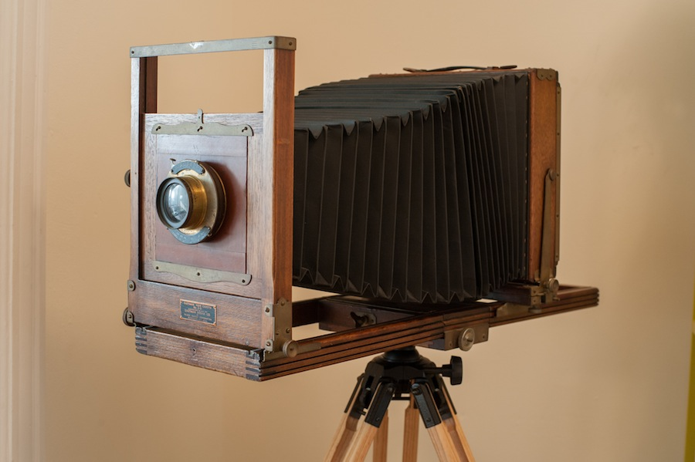
Types of cameras

Slide 25
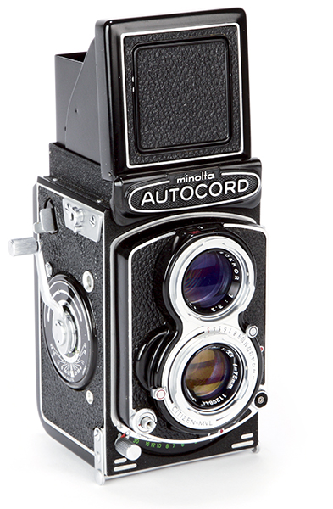
Types of cameras

Slide 26
Types of cameras

Slide 27
Types of cameras

